Slide 1


Project Title: Bike Demand Prediction Project
Project Title: Bike Demand Prediction Project
Student Name: Darsh Sunilkumar Parekh College Name: Shree Swaminarayan Institute of Technology Department: Information Technology Email ID: darshhpp0707@gmail.com
Microsoft Power BI Internship – Capstone Project

Slide 2
Outline:
Introduction
Problem Statement
Proposed System / Solution
System Development Approach
Algorithm & Deployment
Results and Insights
Conclusion
Future Scope
References

Slide 3
Problem Statement:
Bike rental services are becoming very popular in urban cities for short-distance travel.
However, managing bike availability is a major challenge.
At some hours, there are not enough bikes available, while at other times many bikes remain unused.
This imbalance creates problems for both users and bike rental operators.
Without proper planning, it becomes difficult to maintain a stable supply of bikes throughout the day.
Objective of the Project
Analyze historical bike rental data.
Identify patterns in hourly demand.
Predict the number of bikes required at each hour.
Help improve bike distribution using data analytics.

Slide 4
Proposed System / Solution:
The proposed system uses data analytics and visualization to study bike rental demand.
Historical rental data is collected and analyzed to understand usage patterns.
Important factors such as time of day, weather conditions, and weekdays vs weekends are examined.
Using Power BI, the data is visualized through interactive dashboards.
Power BI forecasting features are used to estimate future hourly bike demand.
Benefits
Better planning of bike availability
Improved service for users
Reduced shortage or oversupply of bikes

Slide 5
System Development Approach (Technology Used):
1. Power BI
Used for data analysis and dashboard creation
Helps visualize trends and patterns easily
2. Dataset (Excel / CSV)
Bike rental dataset containing hourly usage information
Includes variables such as time, weather, temperature, and rental count
3. Data Cleaning
Removed missing or incorrect values
Converted data into proper formats
Ensured dataset consistency
4. Data Visualization
Created charts and graphs to analyze bike demand patterns
5. Forecasting
Used Power BI’s built-in forecasting feature to predict future bike demand

Slide 6
Algorithm & Deployment:
Data Inputs
The dataset used in this project includes:
Date and time
Hour of the day
Weather conditions
Temperature and humidity
Number of bikes rented
Forecasting Method
Time-based forecasting using Power BI analytics.
Historical data is used to estimate future hourly demand.
Steps Followed
Imported the dataset into Power BI.
Cleaned and prepared the data.
Created visual charts to analyze demand patterns.
Applied forecasting on the hourly demand chart.
Built an interactive dashboard for better analysis.

Slide 7
Results:
The Power BI dashboard provided useful insights into bike rental patterns.
Key Insights
Hourly Demand Pattern
Highest demand during morning and evening commuting hours.
Weather Impact
Demand decreases during rainy or extremely cold weather.
Weekday vs Weekend Demand
Weekdays show higher demand during office hours.
Weekends show more balanced usage during the day.
Forecasting Results
The forecasting feature predicts future hourly demand trends.
This helps bike rental companies plan bike distribution in advance.

Slide 8
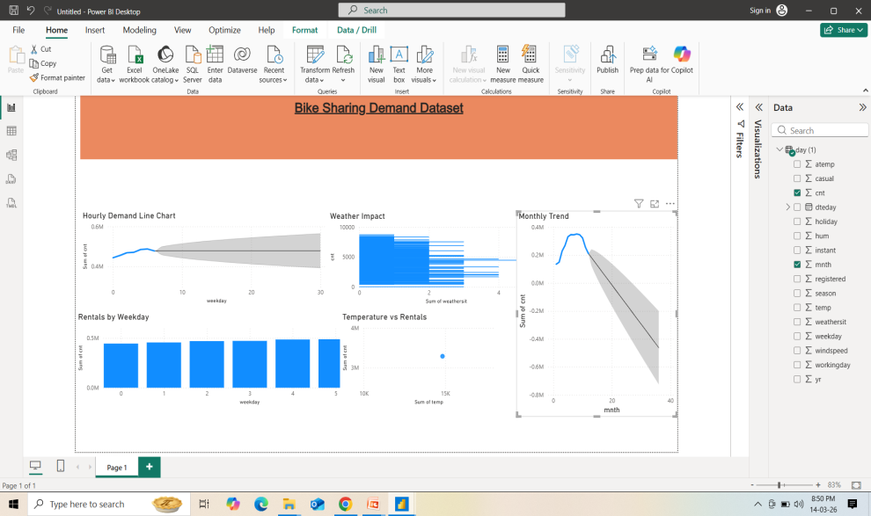
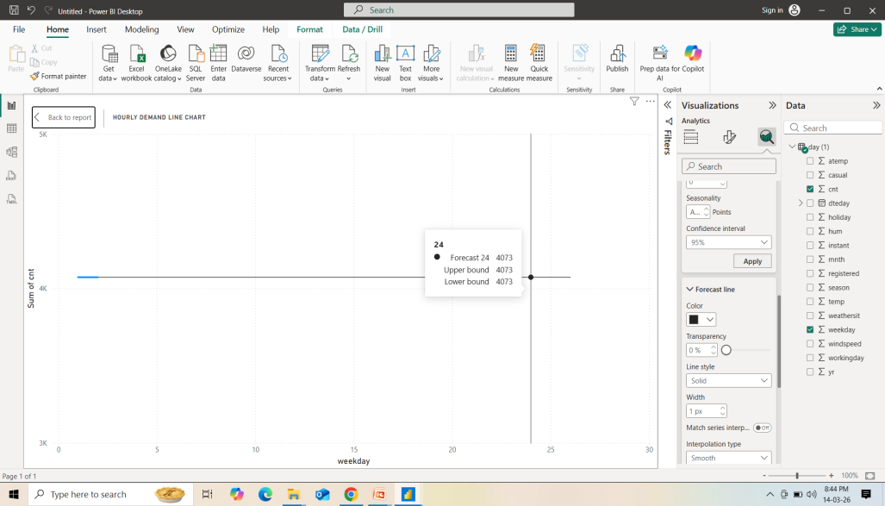
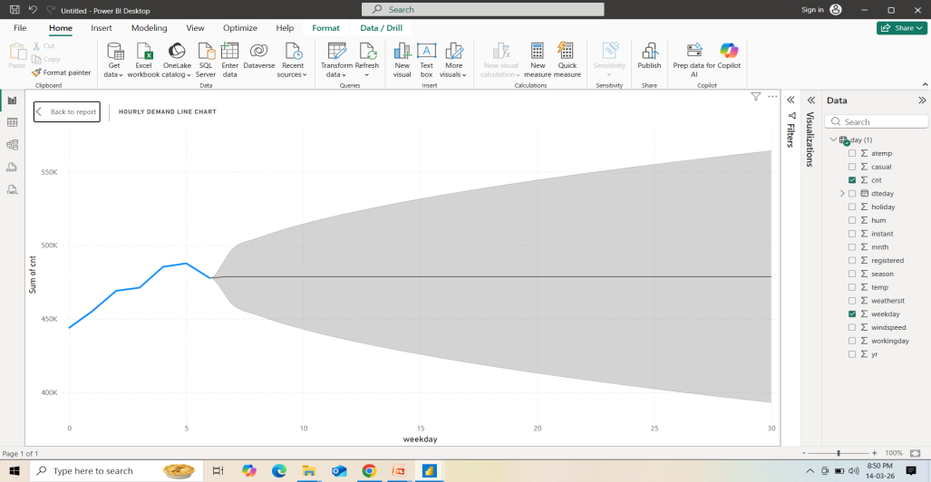
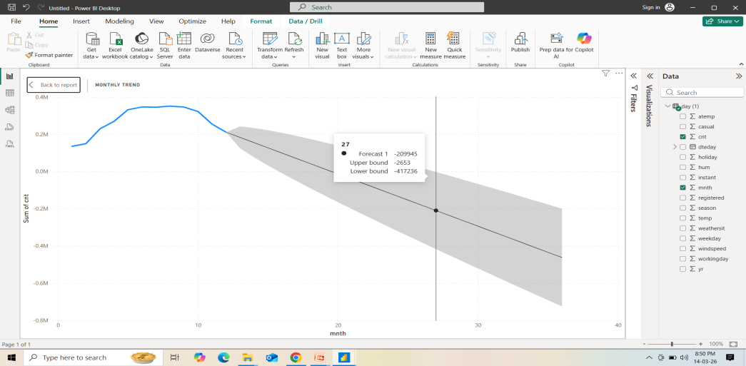
Result Images:
Dashboard overview Including Weather Impact
and Weekday vs Weekend Demand &
Forecasting Results:
Hourly Demand Pattern:
Forecasting Results

Slide 9
GitHub Repository Link:
Here is my GitHub Repository Link given:

Slide 10
Conclusion:
This project analyzed bike rental demand using Power BI dashboards.
Historical data helped identify patterns in hourly bike usage.
Forecasting provided an estimate of future bike demand.
The interactive dashboard makes the insights easy to understand.
Overall, this system can help bike rental services maintain a stable supply of bikes and improve customer experience.

Slide 11
Future Scope:
This project can be improved further in several ways:
Integration with real-time IoT sensors on bikes
Development of a mobile application dashboard
Using machine learning models for more accurate predictions
Expanding the analysis to multiple cities
Integration with live weather data APIs

Slide 12
References:
Kaggle – Bike Sharing Demand Dataset:
Microsoft Learn – Power BI Tutorials:
Research papers on bike sharing demand prediction:
https://share.google/nsxuSiPDf3GHr5GQ7
https://share.google/IWIFrW5YTfZiVjtmD
https://share.google/aSCtI6Tfx0h896v77
Online data analytics learning resources:
https://share.google/5RbT0WIoZG6VLXKi2
https://share.google/hYAT0YyqiN0d0PMae

Slide 13
Thank You

